Slide 1
Market based mechanism
Perform, Achieve and Trade
A.K.ASTHANA
Sr. Technical Expert, GIZ, India

Slide 2
World CO₂ Emission Savings
Gt
45
Current Policies
Scenario
42.6 Gt
Share of cumulative abatement
between 2010-2035
40
7.1 Gt
New Policies
Scenario
Efficiency
50%
35
35.4 Gt
Renewables
18%
Biofuels
4%
30
Nuclear
9%
13.7 Gt
CCS
20%
25
450 Scenario
21.7 Gt
20
Source: WEO 2010
2008
2015
2020
2025
2030
2035
New Policies Scenario is the central scenario in WEO-2010
    assumes cautious implementation of recently announced commitments & plans, even if yet to be formally adopted
  The 450 Scenario sets out an energy pathway consistent with the goal of limiting increase in average temperature to 2^{O}C

Slide 3
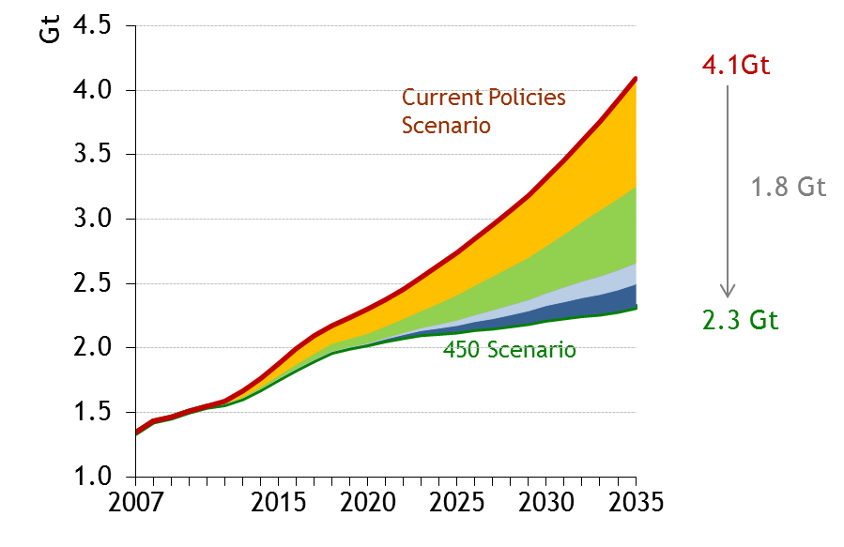
India – CO₂ Emission Reduction
Share of cumulative abatement
between 2010-2035
Efficiency
51%
Renewables
32%
Biofuels
1%
Nuclear
8%
CCS
8%

Slide 4
Energy Profile - India
GHG Emissions Across Sectors
Energy Intensity - Industrial Sector

Slide 5
PAT Scheme Goals and action points
Accelerating the shift to energy efficient appliances in designated sectors through innovative measures to make the products more affordable.
Creation of mechanisms that would help finance demand side management programs in all sectors by capturing future energy savings.
Developing fiscal instruments to promote energy efficiency
Specific Energy Consumption (SEC) reduction targets for the 478 energy-intensive units which are designated consumers under the Energy Conservation Act

Slide 6
Perform, Achieve & Trade (PAT) Mechanism
The market based mechanism to enhance the cost effectiveness in improving the Energy Efficiency in Energy Intensive industries through certification of energy saving which can be traded
  Reward over achiever
  Penalize under performer
  Market Based Mechanism
Administrator
Set target and compliance period
Designated Consumers
8 sectors Thermal Power Plant, Steel, Cement, Fertilizer, Pulp & Paper, Textile, Aluminium, Chlor-alkali
Auditing Agencies
Independent
Monitor, verify and certify
Market Place
Transaction of energy efficiency instrument
Stakeholders
Set Targets
Setting targets on the basis of current specific energy consumption
Monitoring & verification of targets by Designated Energy Auditors (DENA)
Check if designated consumer has achieved targets
Trading of ESCerts
Participation by Designated consumers on platform provided by Power Exchanges
May take into account Location, Vintage, Technology, raw materials, product mix etc.
Underachievement: Obligations to buy ESCerts or pay penalty
Overachievement: Issuance of ESCerts for banking for later use or trade
Set compliance period
Symmetrical flow of information
Processes Involved

Slide 7
Concept of Target, Compliance, Escerts & Penalty
Issued Escerts
Penalty
Baseline SEC
Target
Achieved SEC
Compliance
Target
SEC
Purchase Escerts
Scenario 1
Scenario 2

Slide 8
PAT Activity Flow Sheet
Getting Information Through Base Line Format
Data Compilation/ Evaluation
Target Setting
[Declaration of Base Year, Target Year ]
Communication to Designated Consumer
Preparation Performance Assessment Document (PAD)
Communication to BEE and SDA
Verification of PAD through DENA
Validation of PAD through DENA & submission of compliance doc.
Baseline & Target Setting (based on last three years)
(Annual submission but the target compliance for three years)
Issuance of e-Certs after successful M&V
Market for Trade

Slide 9

Trading of ESCerts

Slide 10
Challenges
Technical
  Scale of Production (Installed Capacities)
  Use of Raw Material
  Process Technology
  Vintage
  O & M Practices
  Type of Product Output
  Variation in output/product
  Plant boundary
  Variation in fuel quality
  Plant load factor
  Monitoring & Verification

Slide 11
PAT Scheme : Background & Scope
Covers 478 designated consumers in 8 sectors
All DCs consume about 165 mtoe energy
Targets would be given to all DCs to achieve the same within a time frame
  Achievement > Target E-Scerts
  Achievement < Target Purchase E-Scerts / Penalty
National Target = 6.6 mtoe at the end of 1st PAT Cycle ( by 2014-15)

Slide 12
PAT Scheme : Approach Towards Target Setting
Sectoral Target will be on pro-rata basis of energy consumption among 8 sectors to achieve National Target
Establishment of Baseline :
  As per reported data of last 5 years (2005-06 to 2009-10)
  Normalization Factor (capacity utilization)
  Arithmetic Average of last 3 years value
Targets to be statistically calculated based on relative SEC approach after grouping the DCs suitably
The target reviewed by an expert committee before notification

Slide 13
General Rules for Establishing Baseline
Definitions:
  Baseline Year : 2009-10
  Baseline Production (P_{base}) : Avg. of 2007-8, 2008-9 & 2009-10
  Baseline SEC (SEC_{base}) : Avg. of 2007-8, 2008-9 & 2009-10
  Baseline CU% (CU_{base}) : Avg. of 2007-8, 2008-9 & 2009-10
  Target SEC (SEC_{target}) : SEC as estimated in 2014-15
  Target : % reduction from SEC_{base}
Estimation of Energy Saving (MTOE) :
P _{base} ( SEC _{base} – SEC _{target} )

Slide 14
Targets For DCs

Slide 17
Thank you

