Slide 1
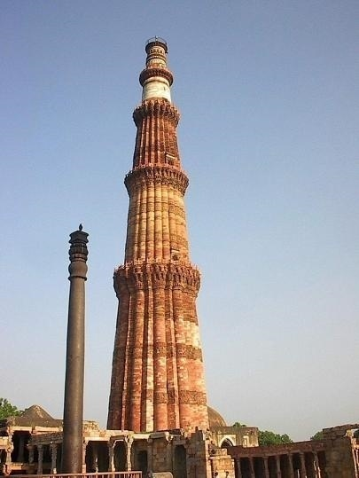
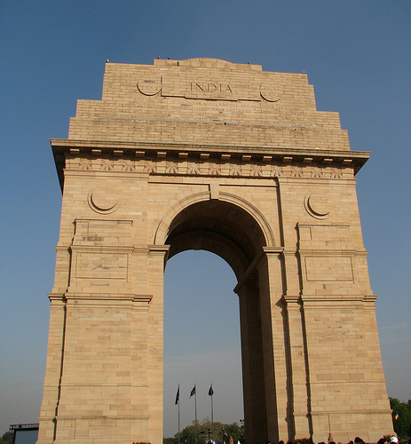
SUSTAINABILITY OF INDIAN DRI INDUSTRY International Conference on Indian Steel Industry: Challenges & Opportunities on 24th March 2012 DEEPENDRA KASHIVA EXECUTIVE DIRECTOR SPONGE IRON MANUFACTURERS ASSOCIATION

Slide 2
INTRODUCTION
In India, DRI mainly used in India as a substitute of steel melting scrap in steel making through DRI– EAF/IF routes.
DRI doesn’t require coking coal - imported in huge quantity. And
Accounts for 40% steel produced in India.
Gas based DRI/HBI is cleanest and environment friendly steel making route (Co2 emission in DRI– EAF route is less than half of Blast Furnace route).
Preferred raw material for making alloy and special steels for vital sectors like automobile, defence, aviation, space etc.

Slide 3
GENESIS – THE BEGINNING

Slide 4
2005
MMTPA
GAS BASED : 6.10
COAL BASED : 10.00
TOTAL CAPACITY : 16.10
2010
GAS BASED : 9.60
COAL BASED : 25.00
TOTAL CAPACITY : 34.60
INDIA LARGEST PRODUCER IN THE WORLD ACCOUNTS FOR 33% OF GLOBAL PRODUCTION (NATION’S PRIDE)

Slide 5
Major players - Essar Steel, JSPL, JSW Ispat, Welspun Maxsteel, TSIL,
Monnet Ispat, Rungta Mines, Godavari Power & Ispat, etc.
Geographical presence – Chhattisgarh, Odisha, West Bengal, Jharkhand,
Gujarat, Maharashtra, Karnataka
No gas based DRI/HBI plant came up after 1994 (17 years)
Major growth in coal based sector during 2003-04 to 2008-09
Reasons for growth – gap between supply & demand of steel, low investment
& low pay back period, high profitability, subsidies & tax holidays in different
states, proximity to main raw materials.
Presently, no small coal based plants (50 PTD, 100 TPD) are being set up

Slide 6
Major presence of coal based units
State | No. of Units | Annual Capacity (MMTPA)
Odisha | 108 | 10.5 (36%)
Chhattisgarh | 68 | 8.0 (27%)
West Bengal | 57 | 4.2 (14%)
Jharkhand | 37 | 2.4 (8%)
These plants are mainly in the vicinity of mining areas
There are about 15 identified clusters comprise essentially of small
plants. Some of major clusters in India:
Majour Clusters
Clusters | Annual Capacity (MMTPA)
Siltara (Chhattisgarh) | 2.94
Rengali (Odisha) | 1.25
Chandil (Jharkhand) | 0.74
Koramunda (Odisha) | 0.72

Slide 7
DRI INDUSTRY – AN OVERVIEW
Domestic DRI capacity more than doubled during 2005-10
India is the largest DRI producer in the world
for last 9 consecutive years. This trend likely to continue
India is also the largest gas based and coal
based DRI producer in the world
Essar is the largest single location gas based
DRI/HBI plant in the world
JSPL is the largest single location coal based
DRI plant in the world
Total investment is more than Rs. 70,000 cr. (includes
downstream)

Slide 8
Growth of steel in India during 2005-10 could not happened
without the support of DRI industry as the growth of steel
making using DRI is almost 4 times than other routes.
Contribution of coal based plants and gas based plants is in
the ratio of about 70:30
This sector provides employment more than 1.5 lac people
It generates over Rs. 50,000 cr. of revenue across the
value chain
It contributes to exchequer more than Rs. 7000 cr.
(Excise Duty – Rs. 5,000 cr., VAT – Rs. 2,000 cr.)
Merchant DRI production could slow down in 5 years due to
increase competition.
Overall pace of growth in DRI slowing down and trend is
likely to continue during the 12th Five Year Plan

Slide 9
Second generation technologies bases on SL/RN developed with a view
to drastically cut capital cost. Such plants were sub-optimally designed
compromising material quality of plant and machinery, life time,
capacity and quality parameters.
Most small capacity plants are performing badly with high break down,
increased maintenance cost with capital repairs of vital equipments
within 10-15 years
Small plants are perceived of highly polluting
Currently, industry is not looked sympathetically. Industry is at the cross
road. Some of the reasons are:
Iron ore
Inadequate availability of iron ore in terms of quantity and quality
Increasing prices of iron ore
PROBLEMS AND CHALLENGES

Slide 10
Non Coking Coal
Inadequate availability of non coking coal in terms of quantity
and quality
Total requirement – 32 MTPA
Availability from CIL sources – 11 MTPA
Imported coal – too costly to afford
Ever increasing prices of coal
Natural Gas
Inadequate availability of natural gas
Total requirement – 7.64 mmscmd
APM gas – 5.36 mmscmd, RIL KG D6- 4.19 mmscmd – Now nil
Present availability - 1.14 mmscmd (about 15%)
Imported LNG – 3 times costlier, too costly to afford

Slide 11
Infrastructure
Inadequate availability of railway wagons
Inadequate road network for transporting vital inputs
and finished goods
Major DRI producers are self power dependent , generating
power through WHRB route, unfortunately, MNRE not consider
this power “green power” in line of bio-mass energy as such
REC not available to them
Environmental Issues
While Gas Based DRI process is highly eco-friendly and energy
efficient, coal based DRI process is highly energy intensive
activity and lead to higher carbon load on climate specially by
small plants

Slide 12
Technological limitations
Technological limitation in the mostly used
module of coal based route
Technological limitations for exploiting inferior
grades of iron ore and coal
Trained Manpower
Shortage of trained manpower as a result plants run
by few trained persons with rest being raw hands.

Slide 13
OPPORTUNITIES
Largest single module of 1000 TPD for coal based route under
development.
About 25 Million Tonnes pellet capacity along with the iron ore
beneficiation facilities under various stages of implementation
This will maximize the usage of iron ore fines and will reduce
the problem of lump iron ore availability
R&D activities are required to promote development of
economically viable and technically feasible technologies
for usage of slimes and other grades of iron ore like BHQ/BHJ
etc.
Tremendous scope of innovations
Limited availability of coking coal in India and abroad will
encourage steel production in the country through combination
of DRI and BF e.g DRI-BF-EAF route.

Slide 14
Tremendous scope for setting up of rotary hearth furnaces and
vertical shaft furnaces for the production of DRI.
Adoption of these types of furnaces will lead to exploiting
inferior grades of raw material (going to be routine in coming
years) and also to overcome to technological limitations of
presently used technology.
Coal gasification in DRI plant of Jindal in Angul (Odisha) will
be game changer. Proved economic variability will lead
setting up of similar plants in India

Slide 15
CONCLUSION
Present global economic crises is affecting Indian iron
and steel Industry.
Small stand alone DRI plants are seriously affected by
raw material scarcity and their ever increasing prices.
Consolidation In the Indian DRI Industry started and will
gain further momentum in times to come
Development of large single module for coal based routes
will encourage the existing and prospective DRI
manufactures to opt for it. This will reduce carbon
load substantially and will also improve financial
performance.

Slide 16
Coal gasification based plant of Jindal will
emerge as a ultimate game changer if it succeeds.
State Governments and Central Government
should provide all required support to this sector
which is vital for the growth of Indian Steel Industry.

Slide 17
THANK YOU

